Slide 1

Ruby on Rails

Slide 2
About today…
Ruby on Rails
Intro
Overview
Features

Slide 3

INTRODUCTION

Slide 4

Intro to RoR
Name
Because it is built using the Ruby programming language, and "Rails"
refers to the framework itself
Creator
David Heinemeier Hansson (DHH)
Initial Release
July 2004 (RoR version 0.5)

Slide 5
Overview
Powerful web development framework written in Ruby
Known for its emphasis on developer productivity and elegant code structure
Several key features that streamline the development process :
Convention over Configuration (CoC)
Don't Repeat Yourself (DRY)
MVC Architecture
Active Record
Gems

Slide 6

Convention over Configuration (CoC)
RoR follows the principle of Convention over Configuration
means it provides sensible defaults and conventions to reduce the need of
manual configuration
Developers can focus more on coding business logic
rather than spending time on configuration details

Slide 7

Don’t Repeat Yourself (DRY)
Encourages developers to avoid redundancy
Writing code that is reusable and modular
Minimizes duplication of code and promotes efficient
coding practices

Slide 8

MVC Architecture
Divides an application into three interconnected components
Models
Represent the data and business logic of the application
Views
Handle the presentation layer, displaying data to users
Controllers
Manage user requests, interact with models, and render appropriate views

Slide 9
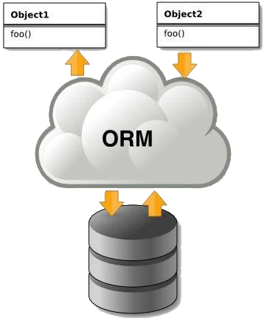
Active Record
Object-Relational Mapping (ORM) framework that
simplifies database interactions
Allows developers to work with databases using Ruby objects
Abstracting away the complexities of SQL queries

Slide 10

Gems
Leverages the RubyGems package manager to integrate libraries and extensions
known as Gems
Extend functionality, providing additional features and capabilities for developers to enhance their applications

Slide 11


Slide 12

What is the meaning of "Rails" in "Ruby on Rails"?
Who is the creator of Ruby on Rails?
When was Ruby on Rails initially released as an open-source framework?
What is the principle of "Convention over Configuration" in Ruby on Rails?
What does the "Don't Repeat Yourself" (DRY) principle in Ruby on Rails emphasize?
What is the role of Active Record in Ruby on Rails?
What is the purpose of a Gemfile in a Ruby on Rails project?

Slide 13

Task 1
Discuss different features of RoR in groups.

